Slide 1

Non-Standard Measurement
GRADE 1 MATH
To listen to Mrs. Unrau explain this lesson,
click play on the speaker in the corner on each page
or choose play slideshow.

Slide 2
What does measurement mean?
Measurement is used to find out the size of an object or how much an object can hold.
You measure to compare objects. You can do this using height, length, width, capacity, area, or weight.

Slide 3
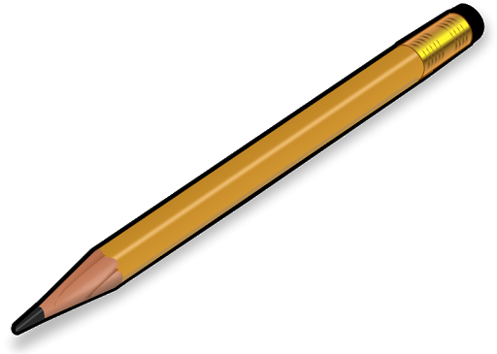
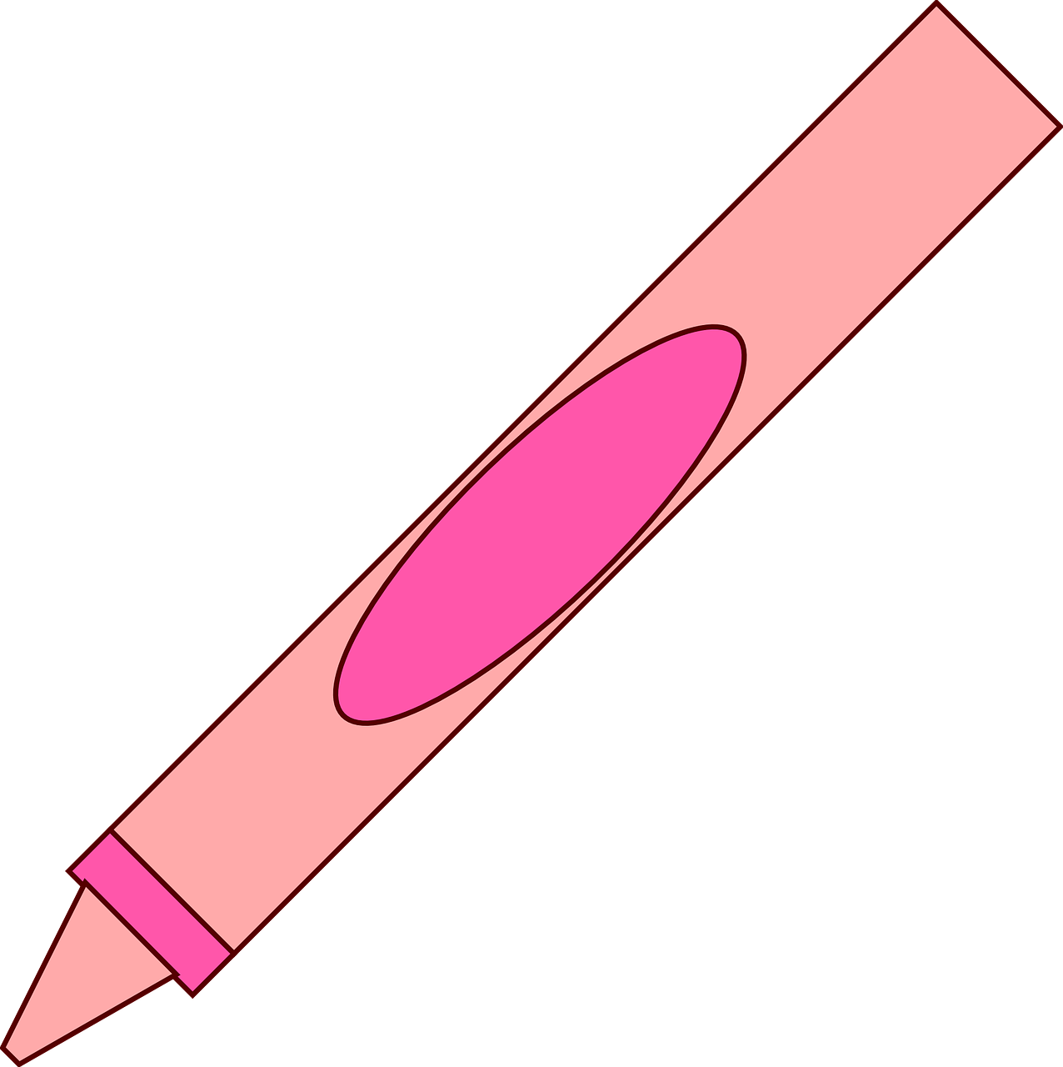
Length
Length means how long or short something is.
The pencil is longer than the crayon.
The crayon is shorter than the pencil.

Slide 4
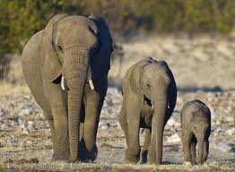
Height
Height means how tall or short an object is.
The first elephant is the tallest.
The third elephant is the shortest.
The second elephant is shorter than the first elephant and taller than the third.

Slide 5
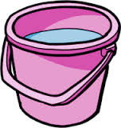
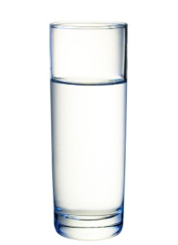
Capacity
Capacity means how much of something an object can hold.
The bucket holds more water than the cup.
The cup holds less water than the bucket.

Slide 6
Area
Area means how much space an object takes up.
The red star covers more of the happy face than the green star.
The green star covers less of the happy face than the red star.

Slide 7
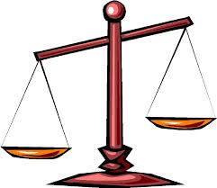
Weight
Weight means how heavy or light an object is.
The teddy bear is heavier than the feather.
The feather is lighter than the teddy bear.

Slide 8
Non-Standard Measurement
In grade one, we measure using non-standard measurement.
That means we don’t use things like rulers, tape measures, or measuring cups.
Nonstandard units of measurement are units that aren't typically used, such as a pencil, blocks, paper clips, or a shoe. You can measure with almost anything!

Slide 9
Non-Standard Measurement
Click the link below to watch a video about measuring using non-standard units!
Introduction to Nonstandard Measurement for Kids: Using Paper Clips to Measure
If the link does not work, type the title into YouTube to find the video.

